Slide 1


BOOTCAMP TRAINING – IDA
WEEK 3 REPORT
- Eeshita Deepta

Slide 2
Day 1 – Case Work
Followings were the learning of Days- 1:
Performed Case Work for the Foundational Training
Used Azure DevOps to create a workflow
Used given website on Github, create a fork and a branch for the website
Made a Virtual Machine on Azure
Installed git on the VM
Installed Maven on the VM
Installed Docker on the VM
Installed Prometheus on the VM
Built the Spring Boot application using Maven
Cloned github repository to VM
Built a docker image
Pushed the changes to repository
Reflected on achievements and challenges of the project

Slide 3
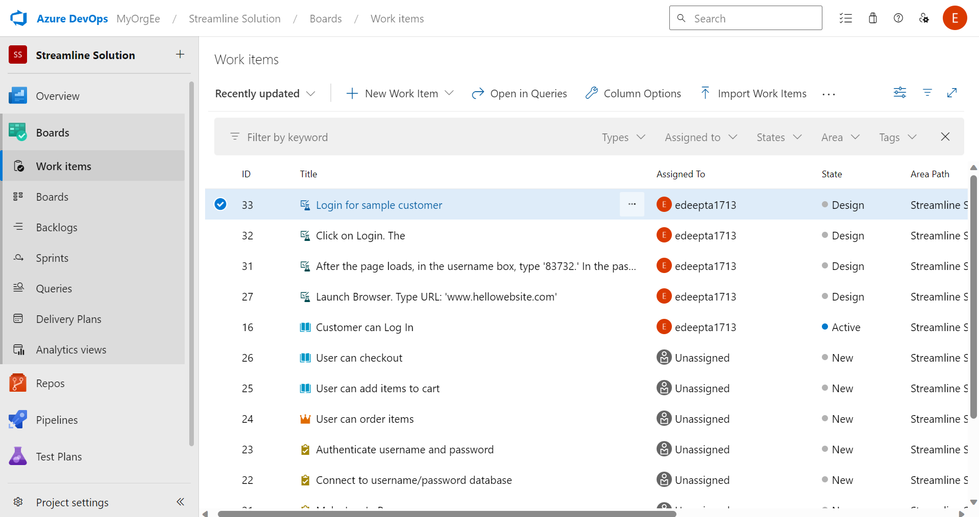

Slide 4
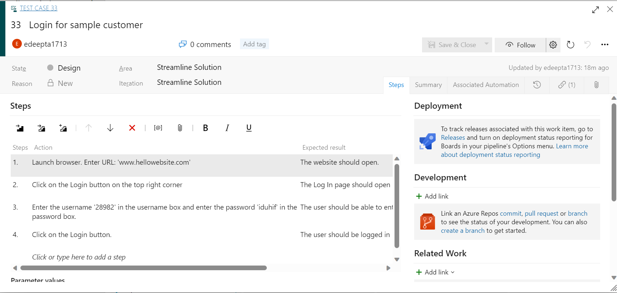

Slide 5
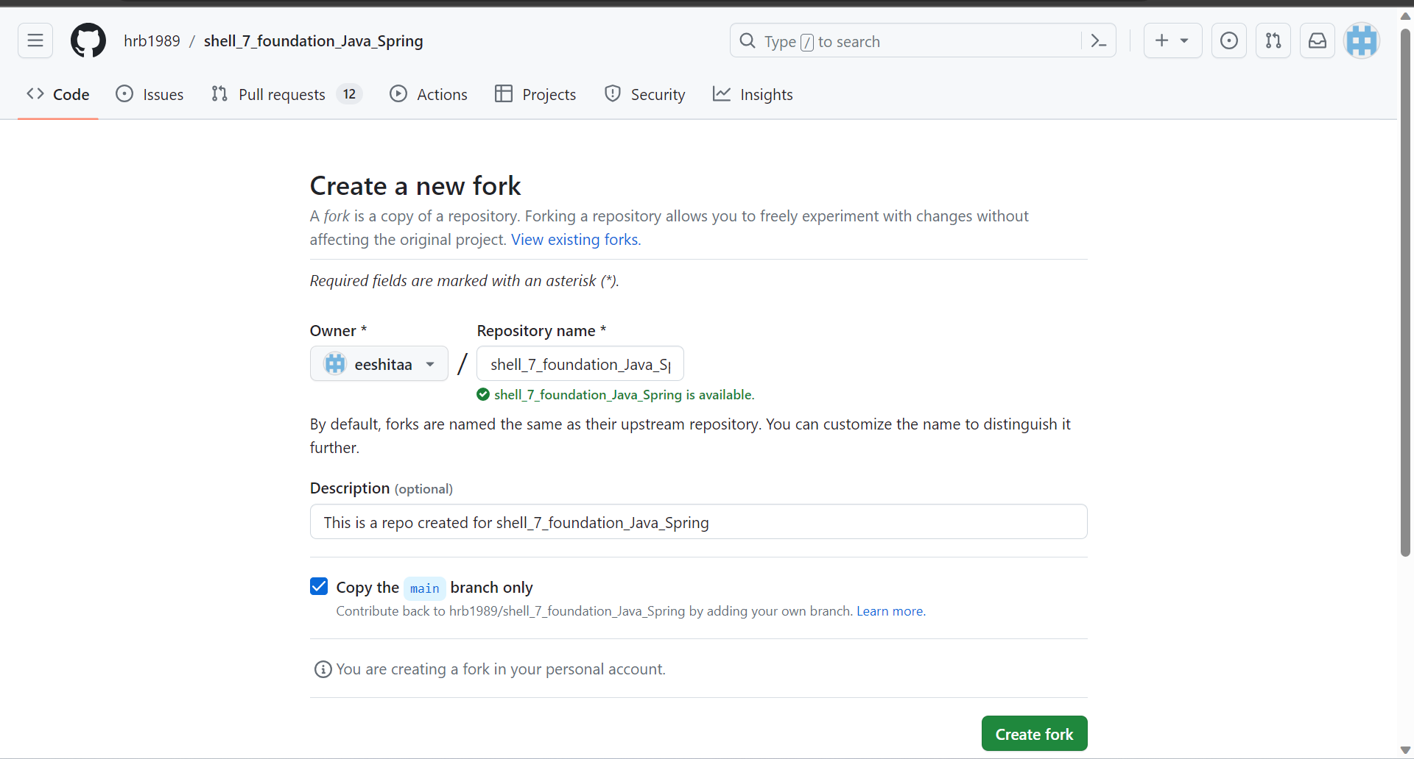

Slide 6
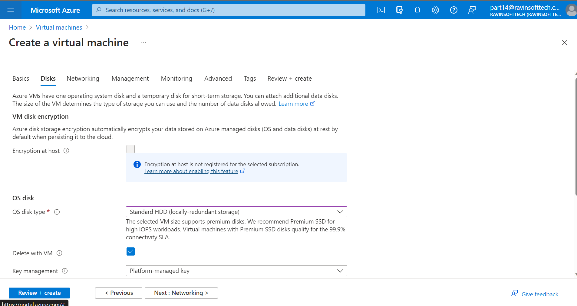

Slide 7
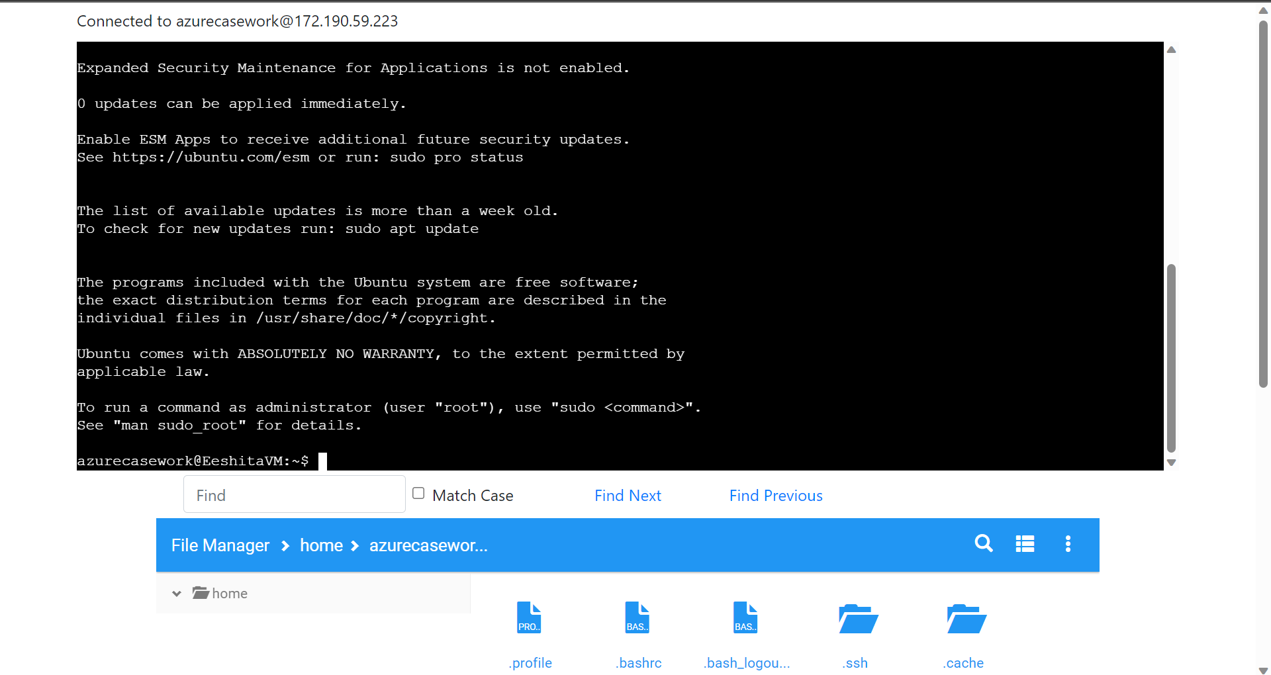

Slide 8
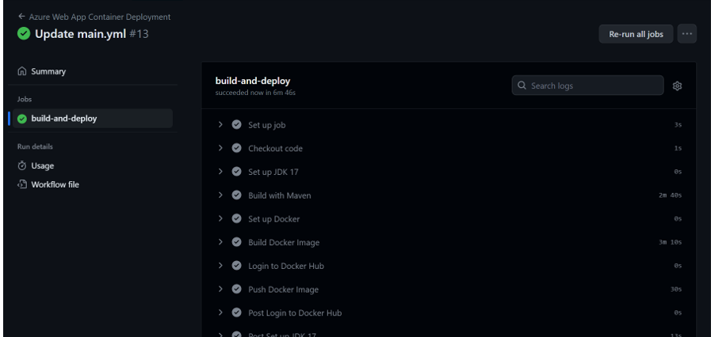

Slide 9
Day – 2 Data Fundamentals
Followings were the learning of Day-2:
Data Warehousing
Data Mining
DBMS and its concepts
ER Modelling
Dimensional Modelling
Star Schems
Snowflake Schema
De-normalization
Data Integration

Slide 10
Day 3 – Big Data & Azure Fundamentals
Followings were the learning of Day-3:
Data Lakes
Data Lakehouses
Types of Big Data (Structured, unstructured, semi-structured
Tools used in Big Data
Using SQL queries
Dimensional Modelling

Slide 11
Day – 4 Azure SQL
Followings were the learning of Day-4:
DDL, DML, DCL
Creating SQL database on Azure
Inserting, Updating and Deleting in SQL
Using Queries in SQL databases
Using group by
Using Inner Join for queries
Aggregation
Using having clause

Slide 12
Day – 5 Azure SQL
Followings were the learning of Day-5:
Using Outer Join, Left Join, Right Join
Giving Assessment
Union
Intersection and subqueries
Working with views and functions
Indexes
Using subqueries
Chasm, Fan and Loop trap

Slide 13
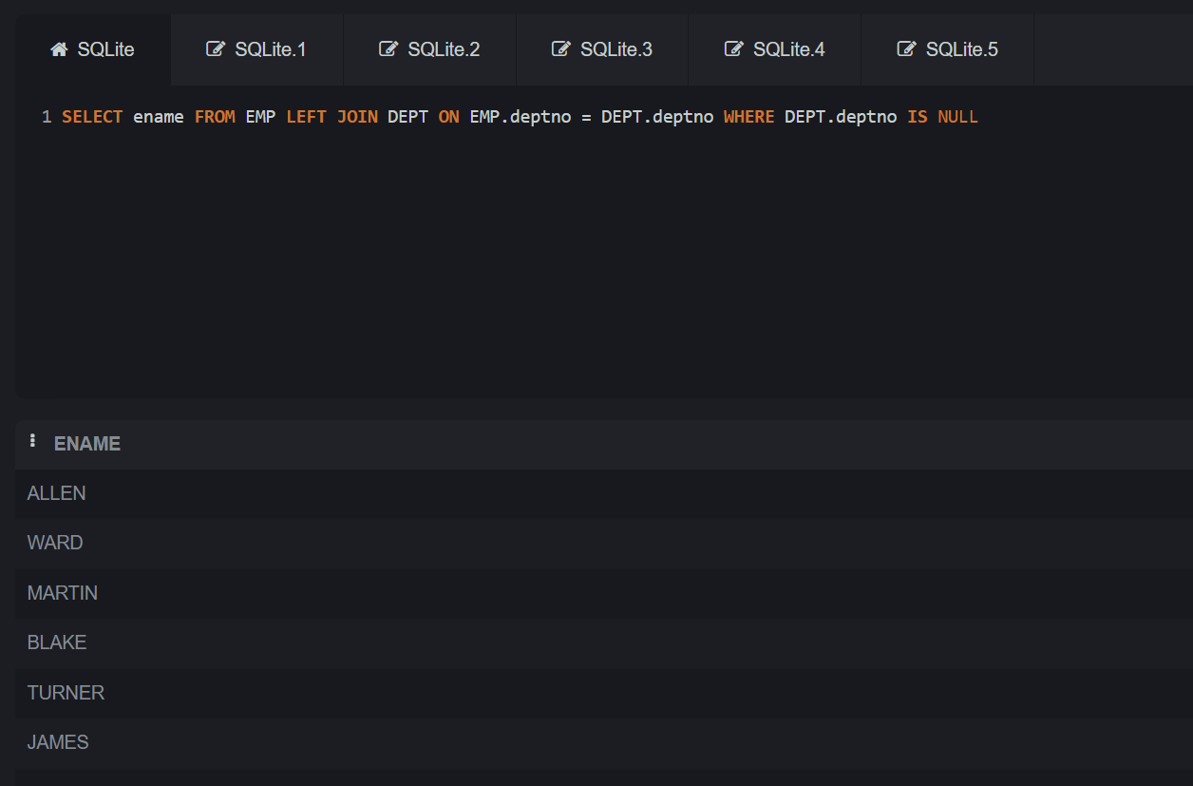

Slide 14
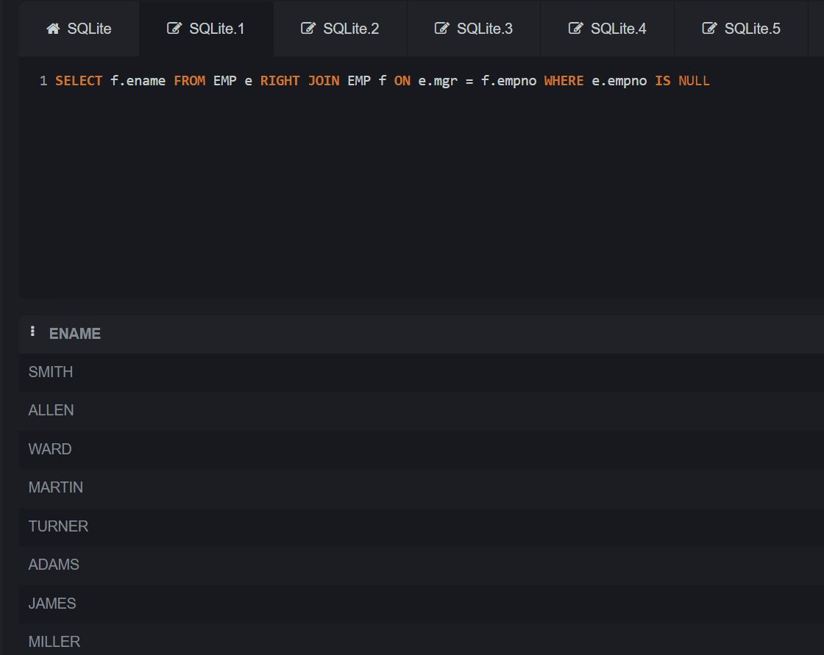

Slide 15
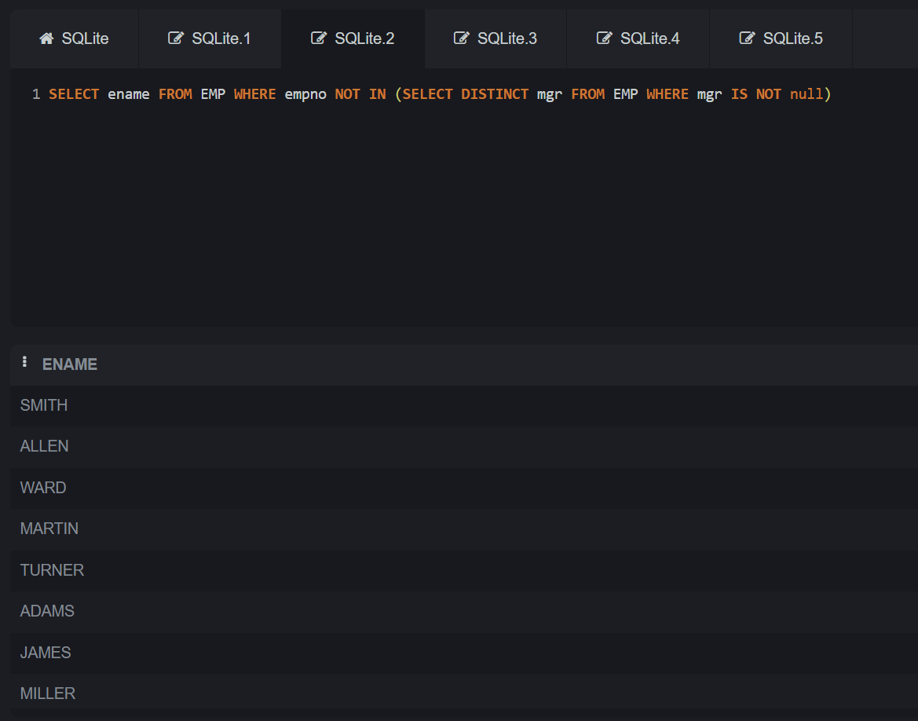

Slide 16
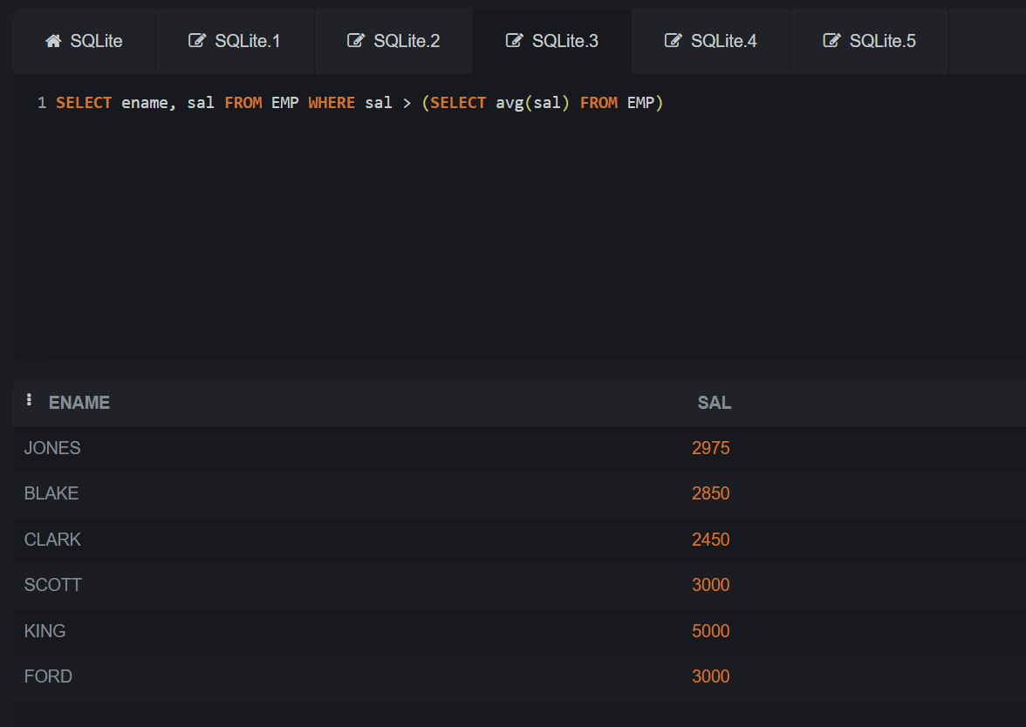

Slide 17
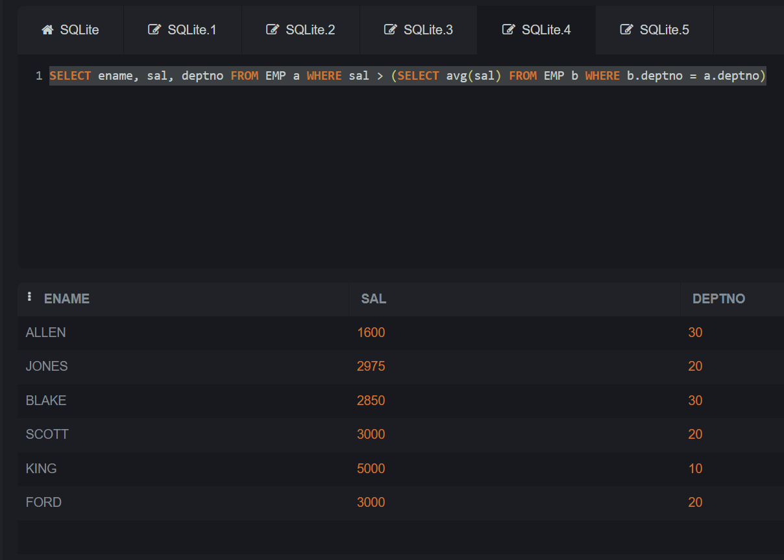

Slide 18
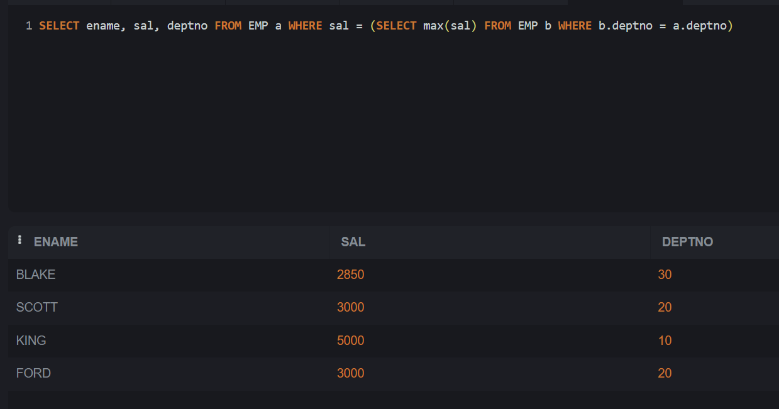

Slide 19
